Slide 1

CRIMINAL IDENTIFICATION IN COLOR SKIN IMAGES USING SKIN MARKS AND FUSION WITH INFERRED VEIN PATTERNS
Team : Project Mentor:
Hemanth kumar R Ms.Riya Roy
Vignesh Yadav
Mohammed Sarver
Nagendra Babu

Slide 3
Abstract :
Problem Statement – Criminal Identification using skin marks and vein
patterns:
inaccurate, time consuming and burden
Solution- Various Algorithms, Image Processing techniques to enhance a Skin image and the Vein pattern
Proposed Model :
Proposed System Advantages: Segmentation Accuracy is high , high accuracy in vein identification.

Slide 4
PROPOSED SYSTEM TECHNIQUES
Skin Image Enhancement.
Skin Segmentation.
RPPVSM Detection.
Vein pattern matching algorithm.

Slide 5
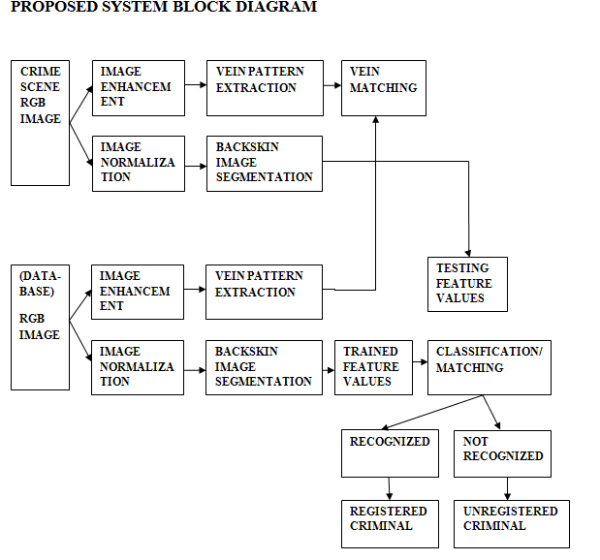

Slide 6
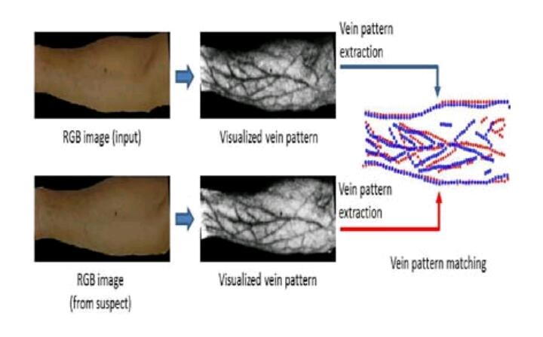
EXAMPLE

Slide 7
Channel Conversion RGB to Ycbcr.
Image Normalization.
Histogram Analysis.
Fuzzy C Means (FCM)Segmentation Algorithm.
Homomorphic Filtering (Preprocesssing).
Multiscale Filtering And Thresholding(Candidate Extracting).
Contrast Limited Adaptive Histogram Equalization (CLAHE)(Image Enhancement).
Local Binary Pattern (LBP)(Feature Extraction).
Gabor Filter (Vein Pattern Extraction).
Shape Feature Extraction.
MultiSVM(Classification).

Slide 8
Channel conversion RGB,YcbCr
The RGB image can be converted into Red channel, Green channel and Blue channel and YCbCr color space model. Luminance (Y) channel, Chrominance (Cb) channel and Chrominance (Cr) channel.
Real-time images and videos are stored in RGB color space, because it is based on the sensitivity of color detection cells in the human visual system.

Slide 9
In digital image processing the YCbCr color space is often used in order to take advantage of the lower resolution capability of the human visual system for color with respect to luminosity. Thus, RGB to YCbCr conversion is widely used in image and video processing.

Slide 10
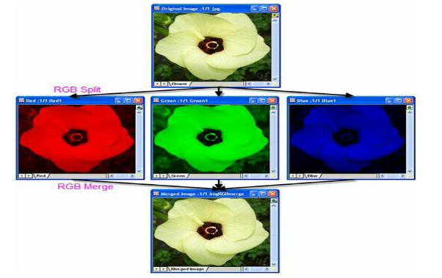
EXAMPLE

Slide 11
Image Normalization
Image normalization is the process that changes the pixel intensity values.
Normalization is sometimes called contrast stretching or histogram stretching.
In more general fields of data processing, such as digital signal processing, it is referred to as dynamic range expansion.
The purpose of dynamic range expansion in the various applications is usually to bring the image, or other type of signal, into a range that is more familiar or normal to the senses, hence the term normalization.

Slide 12
Histogram Analysis
A histogram is an accurate representation of the distribution of numerical data.
It was first introduced by Karl Pearson It is a kind of bar graph.
To construct a histogram, the first step is to "bin" the range of values—that is, divide the entire range of values into a series of intervals—and then count how many values fall into each interval.
The bins are usually specified as consecutive, non-overlapping intervals of a variable.
The bins (intervals) must be adjacent, and are often (but are not required to be) of equal size.

Slide 13
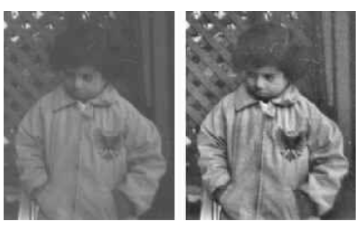
EXAMPLE

Slide 14
FCM Fuzzy c-means
Clustering of data is a method by which large sets of data are grouped into clusters of smaller sets of similar data.
Fuzzy c-means (FCM) clustering algorithm is one of the most commonly used unsupervised clustering technique in the field of medical imaging.
Medical image segmentation refers to the segmentation of known anatomic structures from medical images.
Fuzzy C-means (FCM) is a method of clustering which allows one piece of data to belong to two or more clusters.
Fuzzy logic is a multi-valued logic derived from fuzzy set theory.
FCM is popularly used for soft segmentations like brain tissue model.

Slide 15
Homomorphic filtering
Homomorphic filtering is a generalized technique for signal and image processing, involving a nonlinear mapping to a different domain in which linear filter techniques are applied, followed by mapping back to the original domain.
It simultaneously normalizes the brightness across an image and increases contrast.
Here homomorphic filtering is used to remove multiplicative noise.

Slide 16
Since illumination and reflectance combine multiplicatively, the components are made additive by taking the logarithm of the image intensity, so that these multiplicative components of the image can be separated linearly in the frequency domain.
Illumination variations can be thought of as a multiplicative noise, and can be reduced by filtering in the log domain.
To make the illumination of an image more even, the high-frequency components are increased and low-frequency components are decreased, because the high-frequency components are assumed to represent mostly the reflectance in the scene (the amount of light reflected off the object in the scene), whereas the low-frequency components are assumed to represent mostly the illumination in the scene.
That is, high-pass filtering is used to suppress low frequencies and amplify high frequencies, in the log-intensity domain.

Slide 17
Gabor filter
Gabor filter, named after Dennis Gabor, is a linear filter used for texture analysis, which means that it basically analyses whether there are any specific frequency content in the image in specific directions in a localized region around the point or region of analysis.
Frequency and orientation representations of Gabor filters are claimed by many contemporary vision scientists to be similar to those of the human visual system, though there is no empirical evidence and no functional rationale to support the idea.
They have been found to be particularly appropriate for texture representation and discrimination. In the spatial domain, a 2D Gabor filter is a Gaussiankernel function modulated by a sinusoidalplane wave.

Slide 18
Local binary patterns
LBP is a type of visual descriptor used for classification in computer vision.
LBP is the particular case of the Texture Spectrum model proposed in 1990.
It has since been found to be a powerful feature for texture classification; it has further been determined that when LBP is combined with the Histogram of oriented gradients(HOG) descriptor, it improves the detection performance considerably on some datasets.
A comparison of several improvements of the original LBP in the field of background subtraction was made in 2015 by Silva et al.
A full survey of the different versions of LBP can be found in Bouwmans et al.

Slide 19
Adaptive Histogram Equalization
Adaptive histogram equalization (AHE) is a computer image processing technique used to improve contrast in images.
It differs from ordinary histogram equalization in the respect that the adaptive method computes several histograms, each corresponding to a distinct section of the image, and uses them to redistribute the lightness values of the image.
It is therefore suitable for improving the local contrast and enhancing the definitions of edges in each region of an image.
However, AHE has a tendency to overamplify noise in relatively homogeneous regions of an image.

Slide 20
Contrast Limited AHE
Ordinary AHE tends to overamplify the contrast in near-constant regions of the image, since the histogram in such regions is highly concentrated.
As a result, AHE may cause noise to be amplified in near-constant regions.
Contrast Limited AHE (CLAHE) is a variant of adaptive histogram equalization in which the contrast amplification is limited, so as to reduce this problem of noise amplification.

Slide 21
In CLAHE, the contrast amplification in the vicinity of a given pixel value is given by the slope of the transformation function.
This is proportional to the slope of the neighbourhood cumulative distribution function (CDF) and therefore to the value of the histogram at that pixel value.
CLAHE limits the amplification by clipping the histogram at a predefined value before computing the CDF.
This limits the slope of the CDF and therefore of the transformation function.
The value at which the histogram is clipped, the so-called clip limit, depends on the normalization of the histogram and thereby on the size of the neighbourhood region.
Common values limit the resulting amplification to between 3 and 4.

Slide 22
It is advantageous not to discard the part of the histogram that exceeds the clip limit but to redistribute it equally among all histogram bins.
The redistribution will push some bins over the clip limit again (region shaded green in the figure), resulting in an effective clip limit that is larger than the prescribed limit and the exact value of which depends on the image. If this is undesirable, the redistribution procedure can be repeated recursively until the excess is negligible.

